Slide 1

Optimizing inventory management and minimizing operational cost for enhancing business efficiency of a Cafeteria
Indian Institute of Technology Madras
Chennai, 600036
BDM Capstone Project
Presentation
Diploma in Data Science
Name:Soubhagya Nayak
Roll No:23f2005014
Email:23f2005014@ds.study.iitm.ac.in

Slide 2
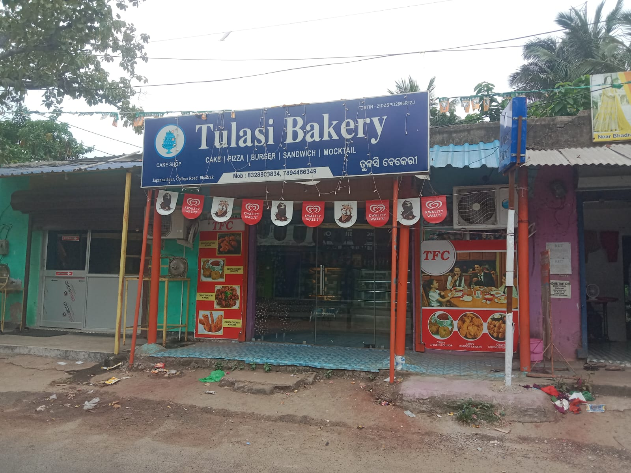

Tulasi Bakery is a small Cafeteria cum fast food restaurant located at College chaka , Bhadrak , Odisha. It provides services in the segment of food related things.
They provide a variety of foods ranging from cakes to snacks and etc. .
The major issue faced by the business was of tracking the inventory , i.e the inflow and outflow of the products.

Slide 3
Problem(s)
Tracking Inventory , Classifying Inventory Materials and Quantify Usage per products to minimize operational costs.
Data
Data was collected over a period of 2 months and it contains several categories like Sales data, Inventory data and Wastage data
Data Analysis and Methods
Various methods were used while analyzing the data to reach the desired solution to the problem.The methods used consists of ABC analysis , Descriptive analysis , Trend analysis and Excel tools.

Slide 4
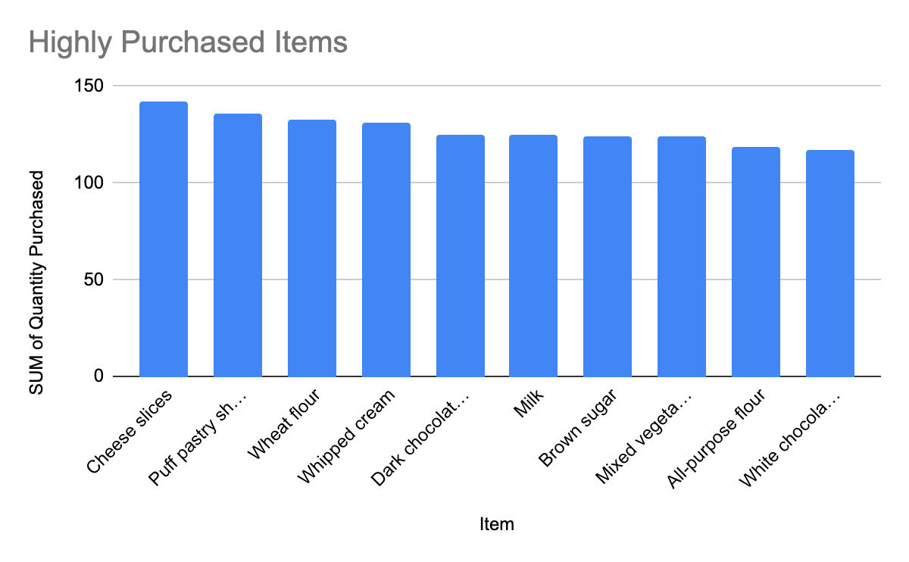
ABC analysis
to categorize products based on their consumption and sales
A items: Most valuable and most used products , requires utmost care and importance.
B items: Moderately used items , requires maintenance but not as much as A category items.
C items: Least used items , requires less care but are necessary for the functioning of the business.
These items are perishable and have a very less life span.So it requires too care .
Items in this categories are purchased in more quantities falling between 100 – 150 units.
Almost all of the items are evenly purchased.

Slide 5
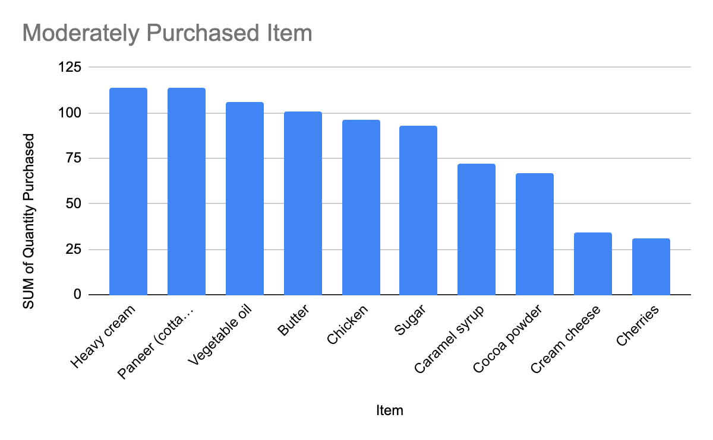
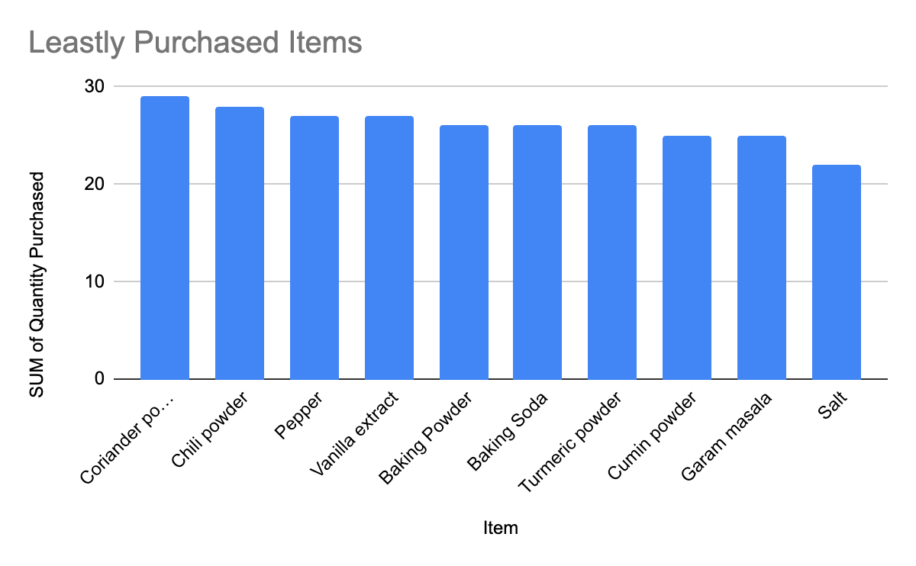
Mostly these items are not as perishable as A category items and hence have a bit longer life span.
Items belonging to categories of spices fall into this category.
They have the longest life span and they need to be purchased in small quantities as they are not used in huge quantities while making food.

Slide 6
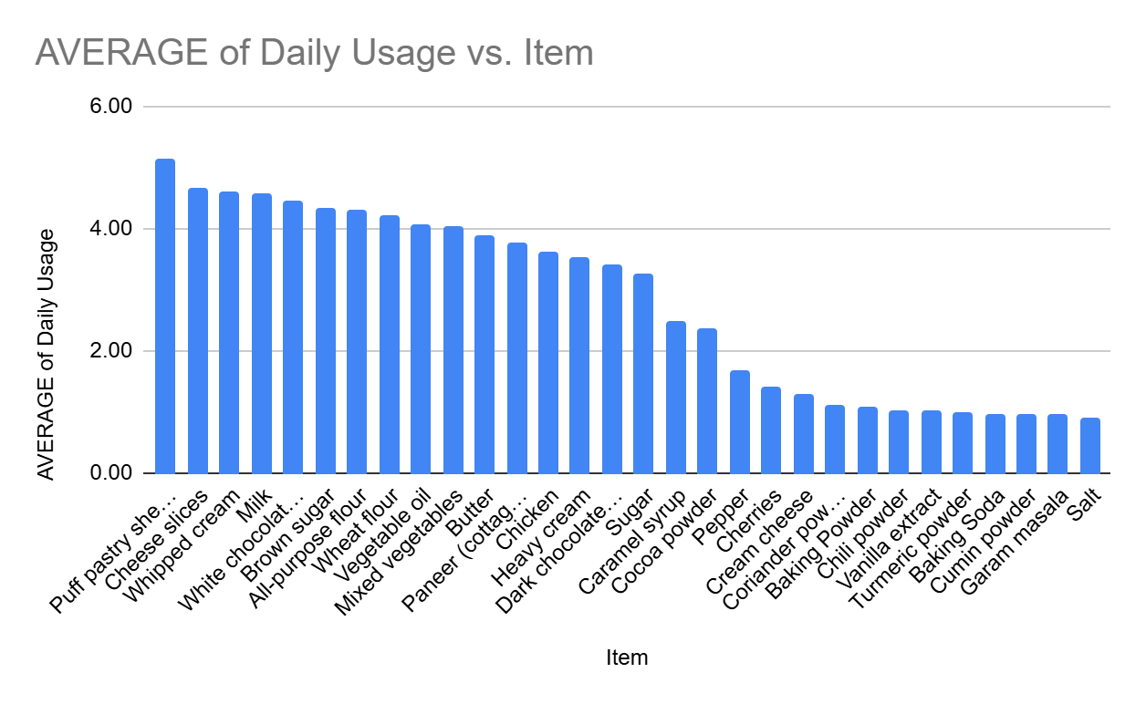
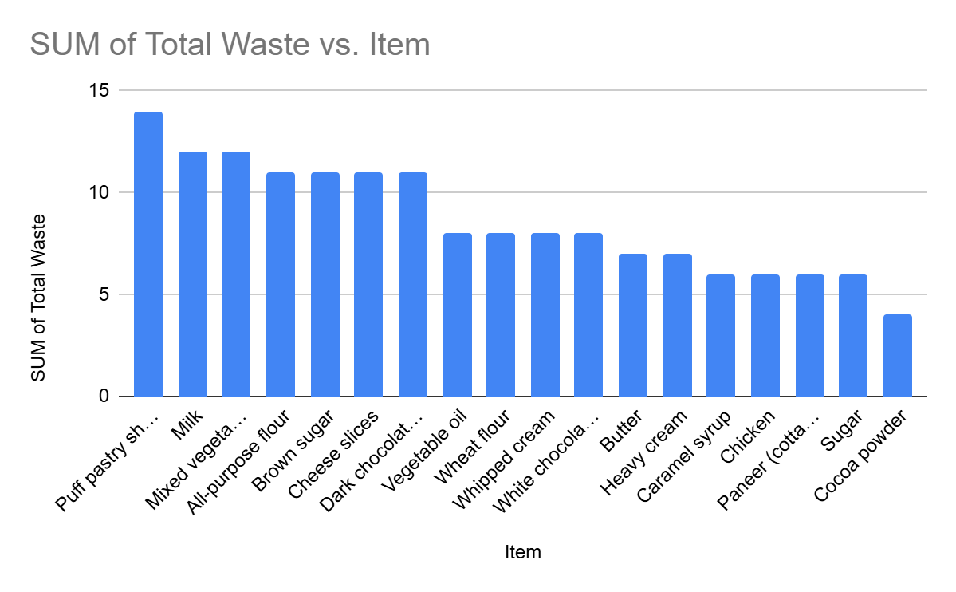
This graph follows the ABC analysis where the most frequently consumed items belong to A category and so on..
The average daily usage data shows that most items have consistent consumption rates, with puff pastry sheets having the highest usage and salt the lowest. This consistency supports the need for balanced inventory levels and highlights areas where inventory management can be improved
Wastage Concerns: The analysis reveals that certain items, such as puff pastry sheets and milk, have higher wastage rates, which points to inefficiencies in inventory control or usage planning. This wastage is particularly concerning for perishable goods with shorter shelf lives, which require more precise inventory management to reduce losses.

Slide 7
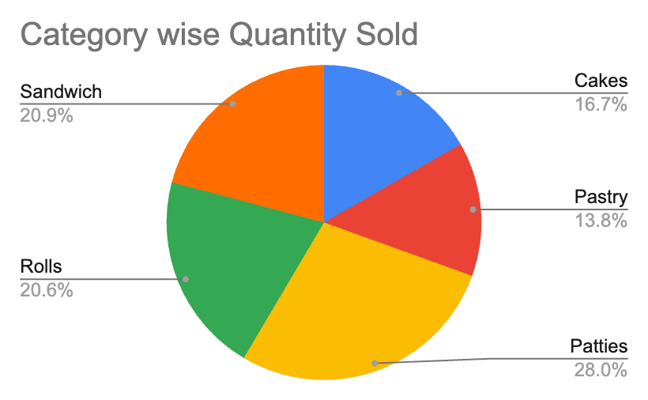
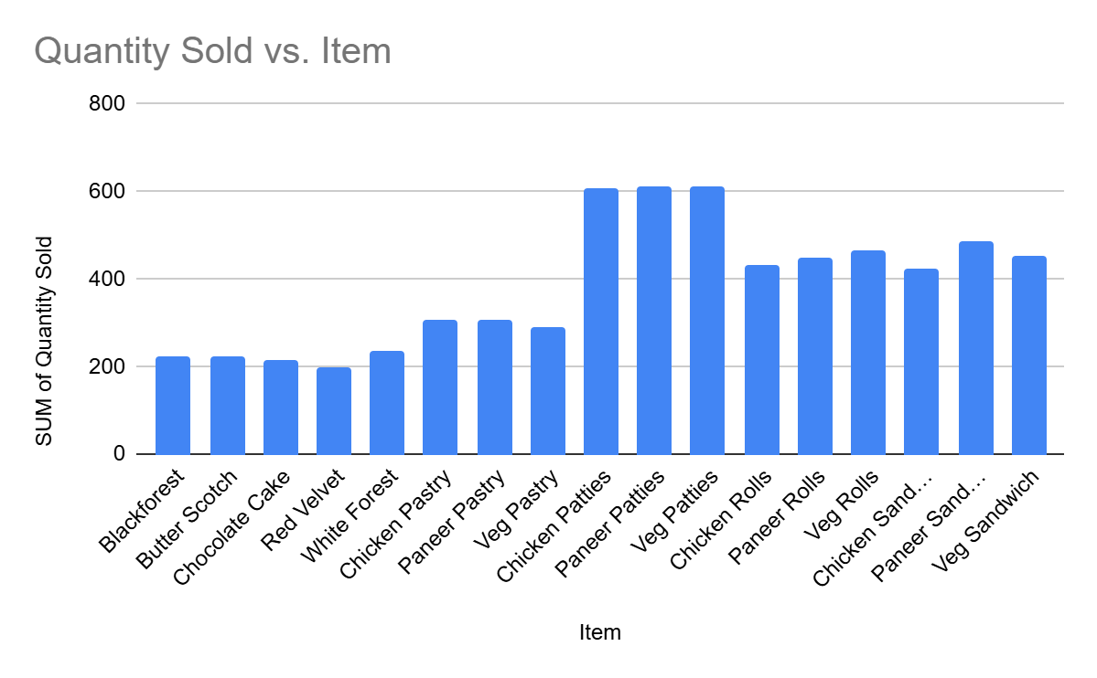
Stable Sales Performance: The sales data shows that the quantity sold remained relatively stable with minor fluctuations. This stability suggests that demand for the products is steady and predictable, which is beneficial for inventory planning and operational consistency.
Sales Distribution: The sales distribution highlights that savory items, such as patties, sandwiches, and rolls, dominate the total sales, while desserts like cakes and pastries have a smaller but still significant contribution. This indicates that the bakery’s menu is well-balanced, catering to a diverse customer base with a strong preference for savory options.

Slide 8
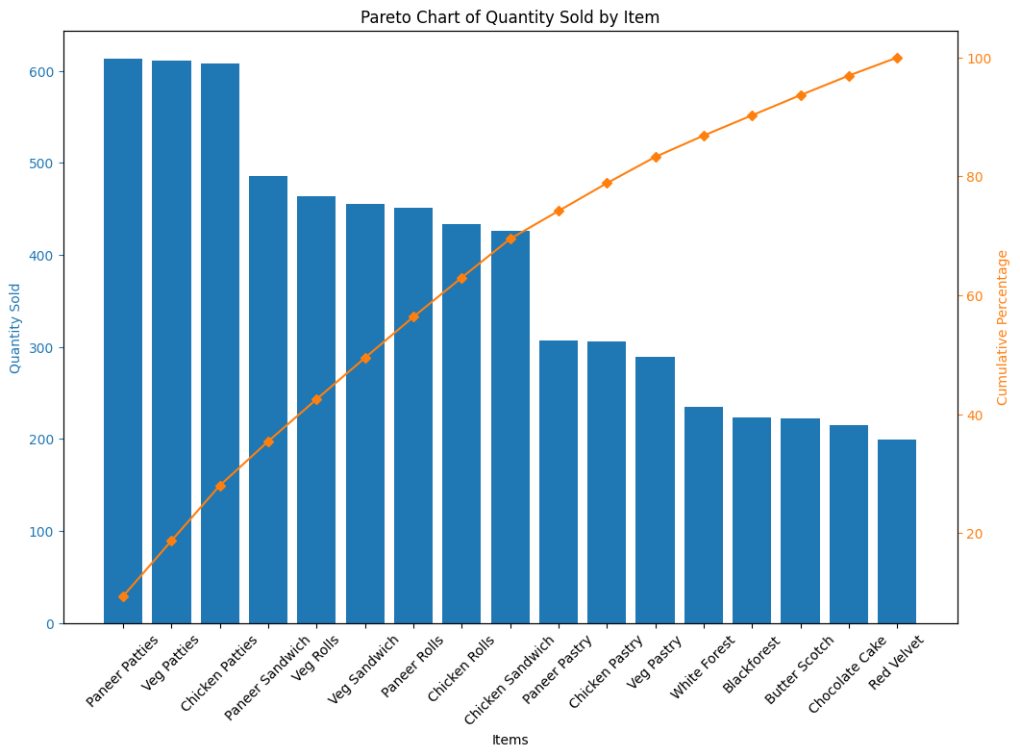
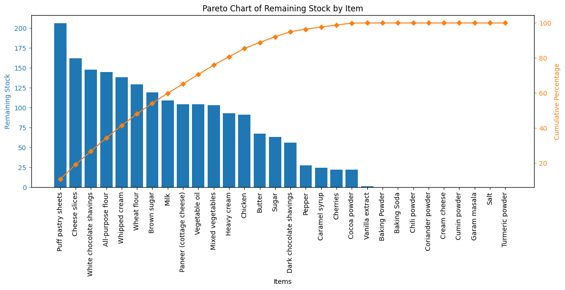
Pareto Analysis
Neither of them follows the Pareto Principle.
It shows that all the items are equally important for the well functioning of the business.

Slide 9
Recommendations
Implement regular inventory audits and monitoring systems to track stock levels and usage more closely.
Use excel for monitoring input and output of products in order to keep track easily and reduce wastage and losses.
Include combo offers in the menu to sell less frequently sold items easily and clearing the inventory.

Slide 10
ThankING you
Soubhagya Nayak
23f2005014
23f2005014@ds.study.iitm.ac.in

